Slide 1


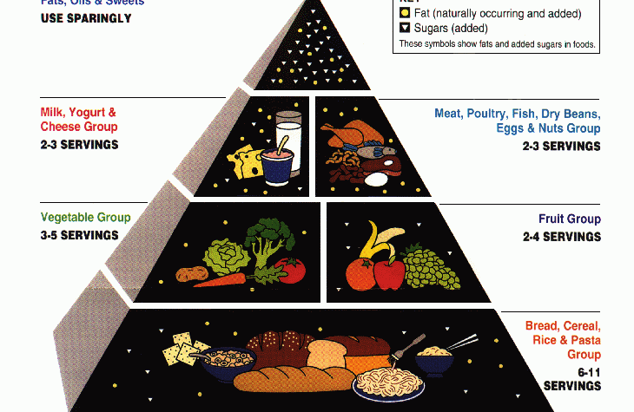
Kitchen Management Assistant
(AI Recipe Assistant-Gemini Chef)
Regarding the Gen AI Intensive Course Capstone 2025Q1

Slide 2
AI Recipe Assistant
Google Gen AI Intensive Capstone Project - 2025Q1
Developed by: Nariman Jafarieshlaghi, Neda Saberitabar

Slide 3
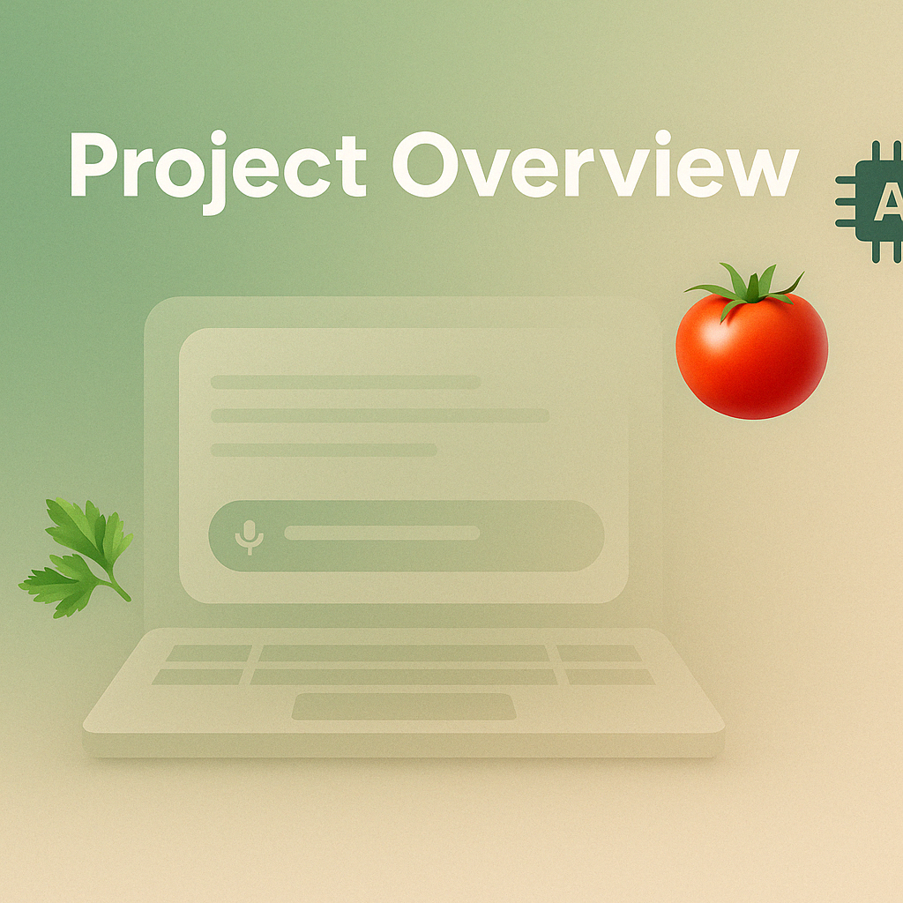
Goal:
Create an AI assistant to help users discover, customize, find useful nutrition information related to specific recipe, and cook recipes.
Key Features:
Recipe discovery via similarity search
Dietary customization
Step-by-step guidance
Voice interaction
Visualized Output
Dashboard for reviews
Ingredient suggestion as substitution

Slide 4

GenAI Capabilities Showcase
This project utilizes multiple GenAI techniques:
Audio Understanding: Processed voice commands (Speech-to-Text).
Function Calling: Enabled agent interaction with database/APIs.
Agents (LangGraph): Orchestrated conversational flow and tool use.
Grounding: Used Google Search for external knowledge/answers.
Embeddings: Powered semantic search for recipes.
Retrieval Augmented Generation (RAG): Retrieved recipes from DB to enhance responses.
Vector Database (ChromaDB): Stored and searched recipe embeddings.
Structured Output (JSON): Facilitated tool interactions and data exchange.
Context Caching & Stateful Conversation: cached state to generate context-aware responses
GenAI evaluation: enabling the agent to reason with structured, fetched data, not just hallucinate

Slide 5
Data Pipeline: Sources & Loading
Food.com Recipes & Interactions (Kaggle)
Food.com R&I Vectorized (Kaggle)
Nutrition API data from USDA FDC

Slide 6
Data Pipeline: Exploration & Cleaning
Exploration:
Analyzed data types, missing values, distributions (cuisine, ingredients)
Cleaning:
Removed duplicate recipes
Normalized ingredient names
Added dietary tags based on keywords

Slide 7
Data Persistence: Databases
1. SQL Database:
Stores structured data, supports SQL queries
2. ChromaDB Vector Database:
Stores recipes & reviews for semantic search

Slide 8
Tooling: Enabling Agent Actions
Tools:
gemini_recipe_similarity_search
get_recipe_by_id
get_ratings_and_reviews_by_recipe_id
fetch_nutrition_from_usda_fdc
customize_recipe (Placeholder)
fetch_live_recipe_data (Placeholder)
SQL tools: list_tables, describe_table, execute_query

Slide 9
Agent Architecture: LangGraph
Built a stateful agent using LangGraph:
KitchenState:
Context, tools, results
Nodes:
Input Parser, Tool Executor, Aggregate Nutrition, Response Formatter, Visualize Nutrition, Review Dashboard, Process Customization
Edges: Conditional logic
LLM: Gemini Flash with tools

Slide 10
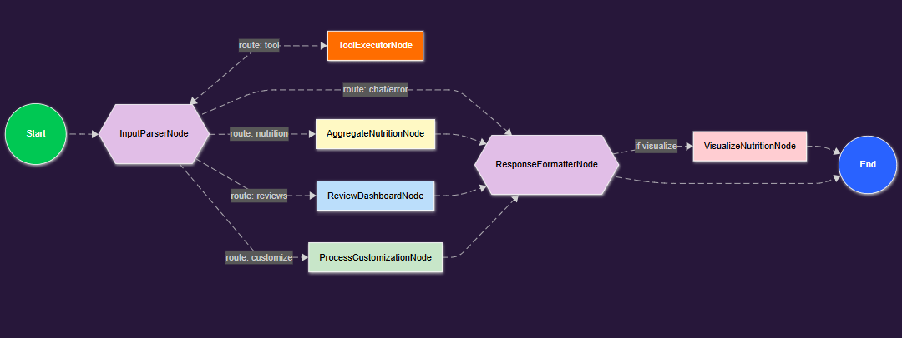
LangGraph Flow Diagram
Shows user input → tool execution → node output

Slide 11
Demo: Recipe Search
User: "Find me vegetarian soup recipes"
Uses gemini_recipe_similarity_search
Returns list of recipes with IDs

Slide 12
Demo: Recipe Details
User: "Tell me about the third one"
- Uses get_recipe_by_id with context
- Displays Recipe Dashboard

Slide 13
Demo: Reviews & Ratings
User: "Show the recipe reviews"
- Uses get_ratings_and_reviews_by_recipe_id
- Displays Review Dashboard

Slide 14
Demo: Recipe Nutrition Analysis
User: "Get nutrition info of this recipe"
- Calls fetch_nutrition_from_usda_fdc per ingredient
- Aggregates results and shows summary

Slide 15
Demo: Nutrition Visualization
(Insert Matplotlib Nutrition Chart)
- Visualizes % Daily Value per 100g

Slide 16
Demo: Recipe Customization
User: "Make this recipe more healthy for low fat diet"
- Uses customize_recipe (LLM)
- Suggests changes

Slide 17
Demo: Grounding (General Question)
User: "What’s a good substitute for egg yolks?"
Uses Gemini + Google Search
Returns substitute list

Slide 18
Demo: Voice Input (Conceptual)
transcribe_audio (Whisper/Google STT)
Simulated UI for voice file upload
Transcription fed to agent

Slide 19
Challenges & Learnings
Challenges:
Complex LangGraph state
Tool output parsing
UI + Visualization
API limits
Learnings:
LangGraph power
Prompt clarity
RAG + Tool use
Error handling

Slide 20
Future Work
Complete customize_recipe tool
Integrated more visual output
Saving user profiles/preferences
Better UI (Gradio/Streamlit)
Enhanced RAG & Testing

Slide 21
Conclusion
Functional kitchen assistant agent
Multi-GenAI feature demo
SQL + Vector DB + API foundation
Many future improvements possible

Slide 22
Thank You
Questions?

